Slide 1
Clustering
Sanjay Ranka
Distinguished Professor
Department of Computer and Information Science and Engineering
www.sanjayranka.com
sanjayranka@gmail.com
352 514 4213

Slide 2
Notion of a Cluster is Ambiguous
Initial points.
Six Clusters
Two Clusters
Four Clusters

Slide 3
Types of Clustering
A clustering is a set of clusters.
One important distinction is between hierarchical and partitional sets of clusters.
Partitional Clustering
A division data objects into non-overlapping subsets (clusters) such that each data object is in exactly one subset.
Hierarchical clustering
A set of nested clusters organized as a hierarchical tree.

Slide 4
Partitional Clustering
Original Points
A Partitional Clustering

Slide 5
Hierarchical Clustering
Traditional Hierarchical Clustering
Traditional Dendrogram
Non-traditional Hierarchical Clustering
Non-traditional Dendrogram

Slide 6
Types of Clusters: Well-Separated
Well-Separated Clusters:
A cluster is a set of points such that any point in a cluster is closer (or more similar) to every other point in the cluster than to any point not in the cluster.

Slide 7
Types of Clusters: Center-Based
Center-based
A cluster is a set of objects such that an object in a cluster is closer (more similar) to the “center” of a cluster, than to the center of any other cluster.
The center of a cluster is often a centroid, the average of all the points in the cluster, or a medoid, the most “representative” point of a cluster.

Slide 8
Types of Clusters: Contiguity-Based
Contiguous Cluster(Nearest neighbor or Transitive)
A cluster is a set of points such that a point in a cluster is closer (or more similar) to one or more other points in the cluster than to any point not in the cluster.

Slide 9
Types of Clusters: Density-Based
Density-based
A cluster is a dense region of points, which is separated by low-density regions, from other regions of high density.
Used when the clusters are irregular or intertwined, and when noise and outliers are present.
The three curves don’t form clusters since they fade into the noise, as does the bridge between the two small circular clusters.

Slide 10
Similarity and Dissimilarity
Similarity
Numerical measure of how alike two data objects are.
Is higher when objects are more alike.
Often falls in the range [0,1]
Dissimilarity
Numerical measure of how different two data objects are.
Is lower when objects are more alike.
Minimum dissimilarity is often 0.
Upper limit varies
Proximity refers to a similarity or dissimilarity

Slide 11
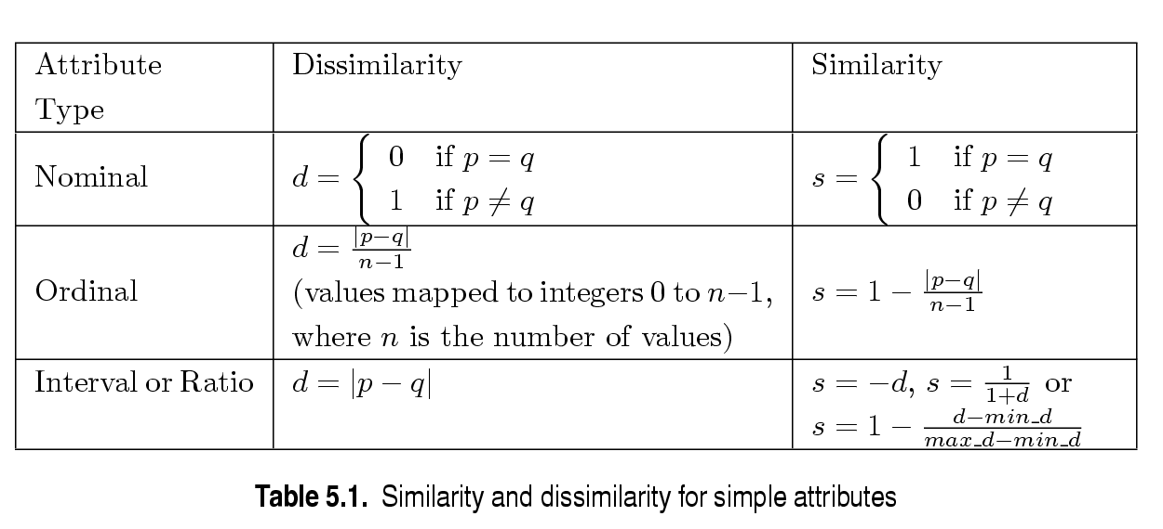
Summary of Similarity/Dissimilarity for Simple Attributes
p and q are the attribute values for two data objects.

Slide 12
Euclidean Distance
Euclidean Distance
where n is the number of dimensions (attributes) and p_{k} and q_{k} are, respectively, the k^{th} attributes (components) or data objects p and q.
Standardization is necessary, if scales differ.

Slide 13
Minkowski Distance
Minkowski Distance is a generalization of Euclidean Distance
where r is a parameter, n is the number of dimensions (attributes) and p_{k} and q_{k} are, respectively, the k^{th} attributes (components) or data objects p and q.

Slide 14
Minkowski Distance: Examples
r = 1. City block (Manhattan, taxicab, L₁ norm) distance.
A common example of this is the Hamming distance, which is just the number of bits that are different between two binary vectors.
r = 2. Euclidean distance.
r → ∞. “supremum” (L_{max} norm, L∞ norm) distance.
This is the maximum difference between any component of the vectors.
Do not confuse r with n, i.e., all these distances are defined for all numbers of dimensions.

Slide 15
Minkowski Distance
Distance Matrix

Slide 16
Common Properties of a Distance and Similarity
Distances, such as the Euclidean distance, have some well-known properties:
d(p, q) ≥ 0 for all p and q and d(p, q) = 0 only if p = q. (Positive definiteness)
d(p, q) = d(q, p) for all p and q. (Symmetry)
d(p, r) ≤ d(p, q) + d(q, r) for all points p, q, and r. (Triangle Inequality)
where d(p, q) is the distance (dissimilarity) between points (data objects), p and q.
A distance that satisfies these properties is a metric
Similarities, also have some well-known properties:
s(p, q) = 1 (or maximum similarity) only if p = q.
s(p, q) = s(q, p) for all p and q. (Symmetry)
where s(p, q) is the similarity between points (data objects), p and q.

Slide 17
Similarity Between Binary Vectors
Common situation is that objects, p and q, have only binary attributes.
Compute similarities using the following quantities
M₀₁ = the number of attributes where p was 0 and q was 1
M₁₀ = the number of attributes where p was 1 and q was 0
M₀₀ = the number of attributes where p was 0 and q was 0
M₁₁ = the number of attributes where p was 1 and q was 1
Simple Matching and Jaccard Coefficients
SMC = number of matches / number of attributes
= (M₁₁ + M₀₀) / (M₀₁ + M₁₀ + M₁₁ + M₀₀)
J = number of 11 matches / number of not-both-zero attributes values
= (M₁₁) / (M₀₁ + M₁₀ + M₁₁)

Slide 18
SMC versus Jaccard: Example
p = 1 0 0 0 0 0 0 0 0 0
q = 0 0 0 0 0 0 1 0 0 1
M₀₁ = 2 (the number of attributes where p was 0 and q was 1)
M₁₀ = 1 (the number of attributes where p was 1 and q was 0)
M₀₀ = 7 (the number of attributes where p was 0 and q was 0)
M₁₁ = 0 (the number of attributes where p was 1 and q was 1)
SMC = (M₁₁ + M₀₀) / (M₀₁ + M₁₀ + M₁₁ + M₀₀)
= (0+7) / (2+1+0+7) = 0.7
J = (M₁₁) / (M₀₁ + M₁₀ + M₁₁)
= 0 / (2 + 1 + 0) = 0

Slide 19
Cosine Similarity
If d₁ and d₂ are two document vectors, then
cos( d₁, d₂ ) = (d₁ • d₂) / ||d₁|| ||d₂|| ,
where • indicates vector dot product and || d || is the length of vector d.
Example:
d₁ = 3 2 0 5 0 0 0 2 0 0
d₂ = 1 0 0 0 0 0 0 1 0 2
d₁ • d₂= 3*1 + 2*0 + 0*0 + 5*0 + 0*0 + 0*0 + 0*0 + 2*1 + 0*0 + 0*2 = 5
||d₁|| = (3*3+2*2+0*0+5*5+0*0+0*0+0*0+2*2+0*0+0*0)^{0.5} = (42) ^{0.5} = 6.481
||d₂|| = (1*1+0*0+0*0+0*0+0*0+0*0+0*0+1*1+0*0+2*2) ^{0.5} = (6) ^{0.5} = 2.245
cos( d₁, d₂ ) = .3150

Slide 20
Correlation
Correlation measure the linear relationship between objects.
To compute correlation, we standardize data objects, p and q, and then take the dot product.

Slide 21
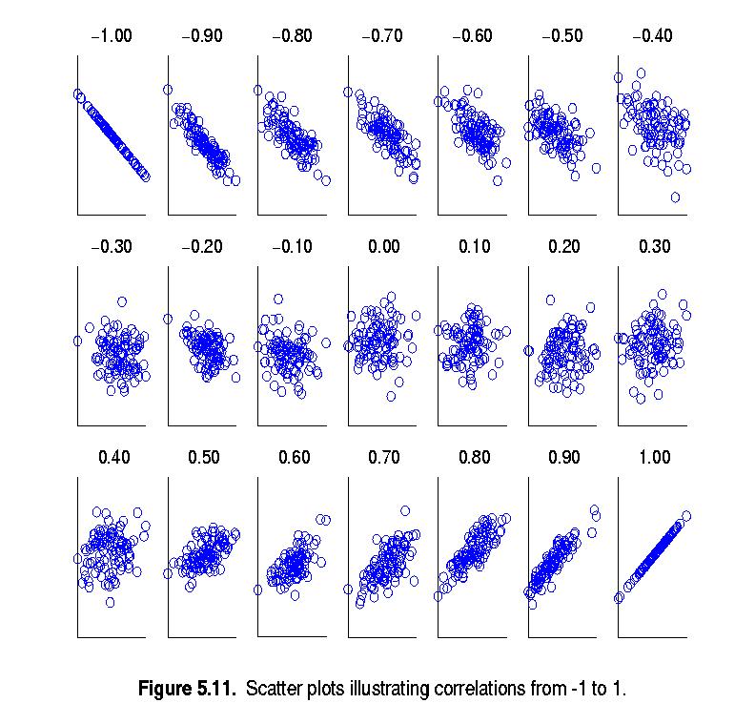
Visually Evaluating Correlation
Scatter plots showing the similarity from –1 to 1

Slide 22
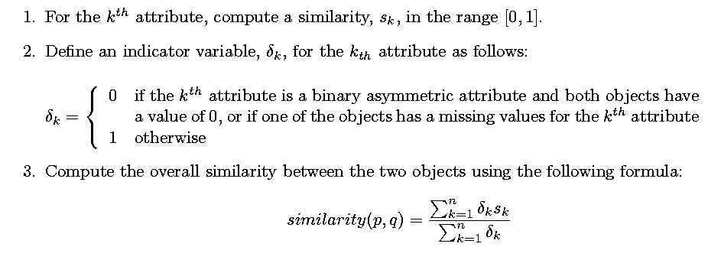
General Approach for Combining Similarities
Sometimes attributes are of many different types, but an overall similarity is needed.

Slide 23

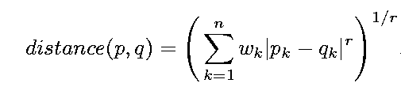
Weighted Similarity
May not want to treat all attributes the same.
Use weights w_{k} which are between 0 and 1 and sum to 1.

Slide 24
Partitional Clustering
Original Points
A Partitional Clustering

Slide 25
Hierarchical Clustering
Traditional Hierarchical Clustering
Traditional Dendrogram

Slide 26
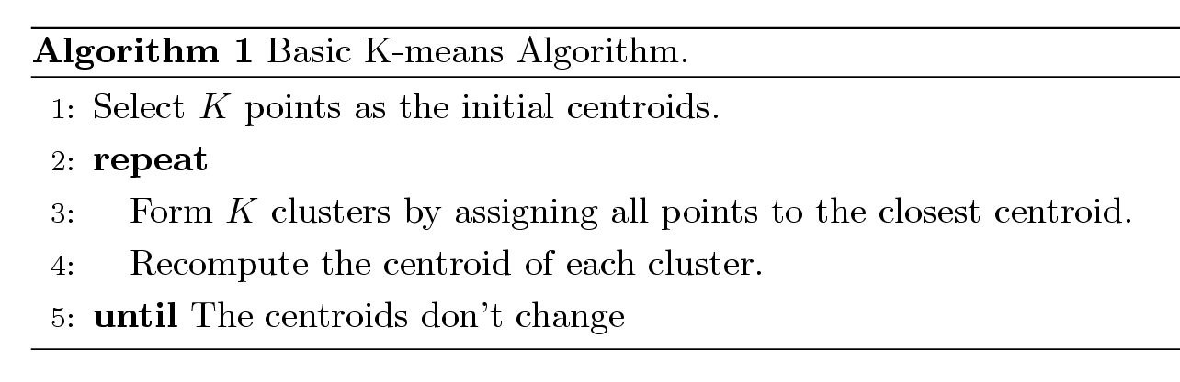
K-means Clustering
Partitional clustering approach
Each cluster is associated with a centroid (center point)
Each point is assigned to the cluster with the closest centroid.
Number of clusters, K, must be specified.
The basic algorithm is very simple.

Slide 27
K-means Clustering – Details
Initial centroids are often chosen randomly.
Clusters produced vary from one run to another.
The centroid is (typically) the mean of the points in the cluster.
‘Closeness’ is measured by Euclidean distance, cosine similarity, correlation, etc.
K-means will converge for common similarity measures mentioned above.
Most of the convergence happens in the first few iterations.
Often the stopping condition is changed to ‘Until relatively few points change clusters’
Complexity is O( n * K * I * d )
n = number of points, K = number of clusters, I = number of iterations, d = number of attributes

Slide 28
Evaluating K-means Clusters
Most common measure is the Sum of the Squared Error (SSE)
For each point, the error is the distance to the nearest cluster.
To get SSE, we square these errors and sum them.
Given two clusters, we can choose the one with the smallest error.
One easy way to reduce SSE is to increase K, the number of clusters.
A good clustering with smaller K can have a lower SSE than a poor clustering with higher K.

Slide 29
Two different K-means Clustering
Original Points Optimal Clustering Sub-optimal Clustering

Slide 30
Importance of Choosing - Initial Centroids

Slide 31
Importance of Choosing - Initial Centroids

Slide 32
Importance of Choosing Initial Centroids …

Slide 33
Importance of Choosing Initial Centroids …

Slide 34
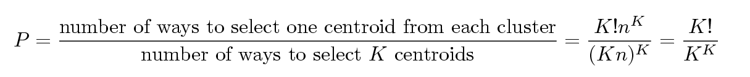
Problems with Selecting Initial Points
If there are K ‘real’ clusters then the chance of selecting one centroid from each cluster is small.
Chance is relatively small when K is large
If clusters are the same size, n, then
For example, if K = 10, then probability = 10!/1010 = 0.00036
Sometimes the initial centroids will readjust themselves in ‘right’ way, and sometimes they don’t
Consider an example of five pairs of clusters

Slide 35
10 Clusters Example
Starting with two initial centroids in one cluster of each pair of clusters

Slide 36
10 Clusters Example
Starting with two initial centroids in one cluster of each pair of clusters

Slide 37
10 Clusters Example
Starting with some pairs of clusters having three initial centroids, while other have only one.

Slide 38
10 Clusters Example
Starting with some pairs of clusters having three initial centroids, while other have only one.

Slide 39
Solutions to Initial Centroids Problem
Multiple runs
Helps, but probability is not on your side
Bisecting K-means
Not as susceptible to initialization issues
Sample and use hierarchical clustering to determine initial Centroids
Select more than K initial centroids and then select among these initial centroids
Select most widely separated
Post-processing

Slide 40
Pre-processing and Post-processing
Pre-processing
Normalize data so distance computations are fast.
Eliminate outliers
Post-processing
Eliminate small clusters that may represent outliers
Split ‘loose’ clusters, i.e., clusters with relatively high SSE
Merge clusters that are ‘close’ and that have relatively low SSE
Can use these steps during the clustering process
ISODATA

Slide 41
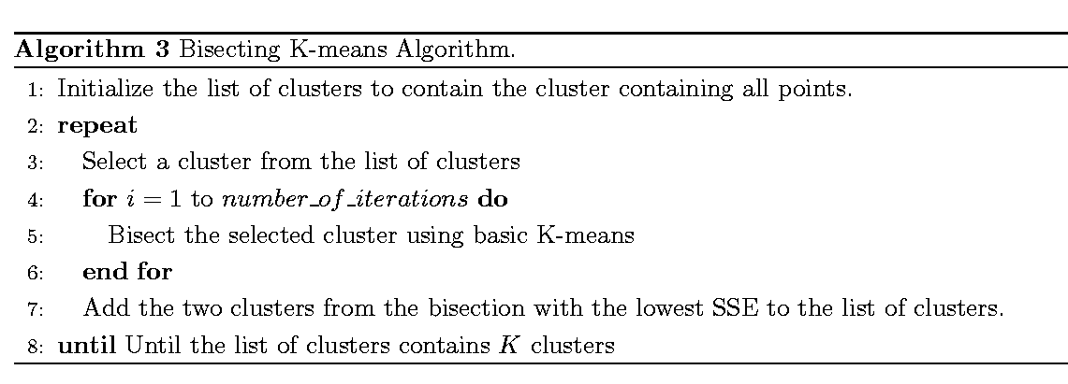
Bisecting K-means
Bisecting K-means algorithm
Variant of K-means that can produce a partitional or a hierarchical clustering

Slide 42
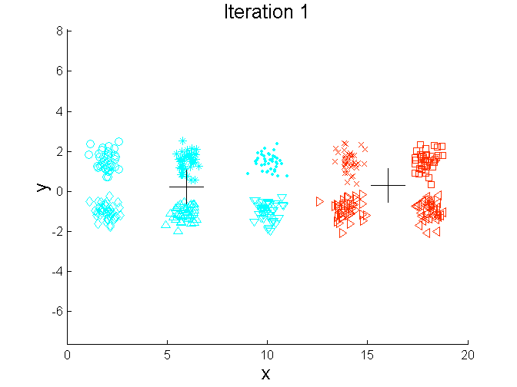
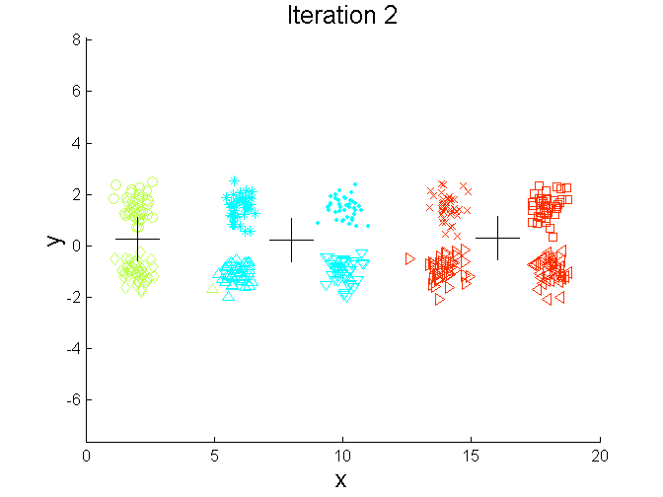
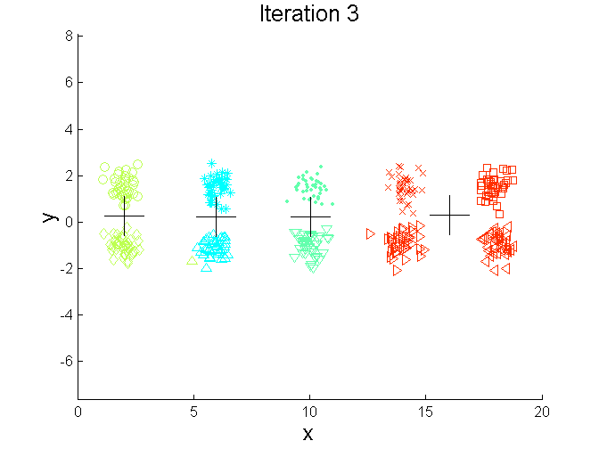
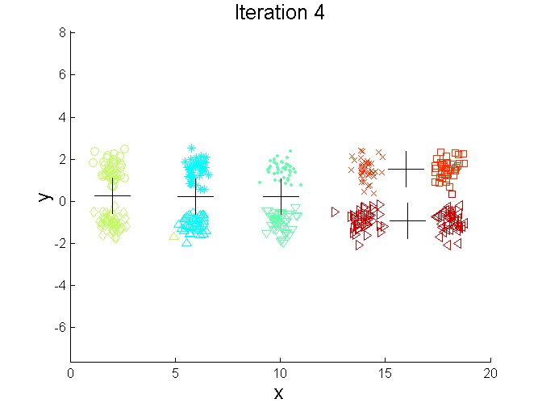
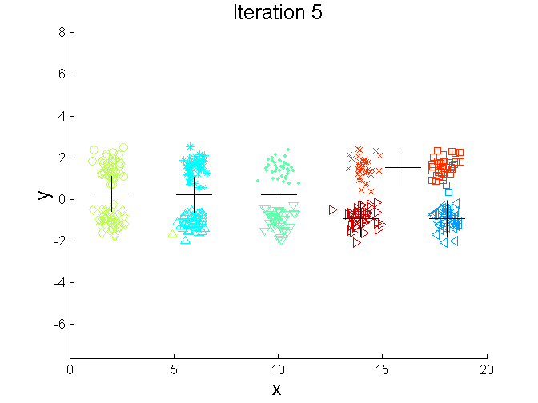
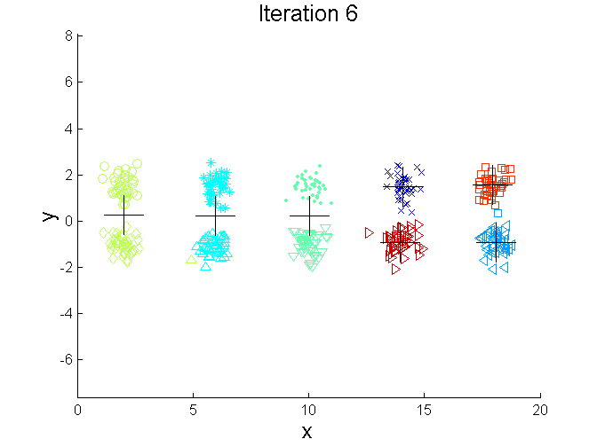
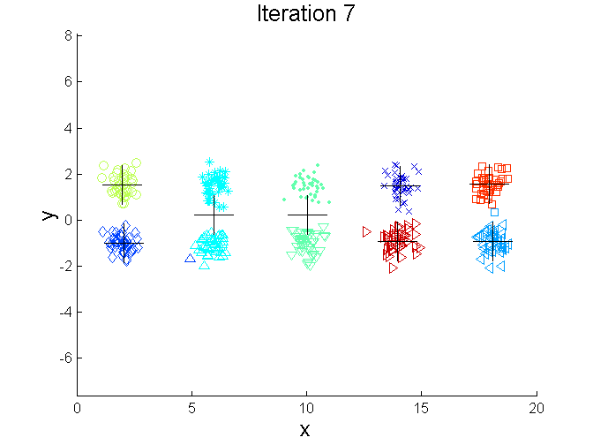
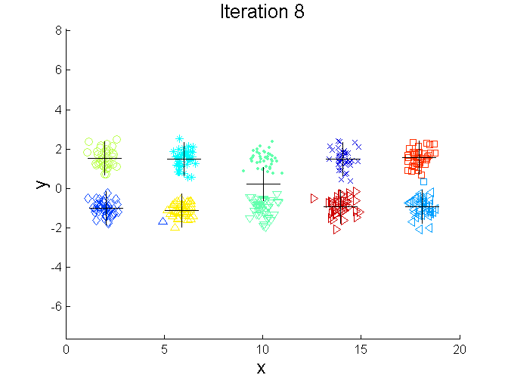
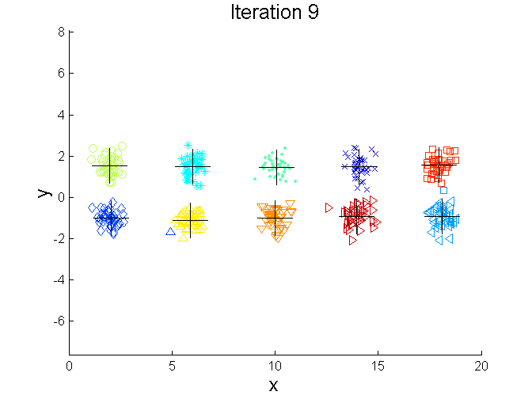
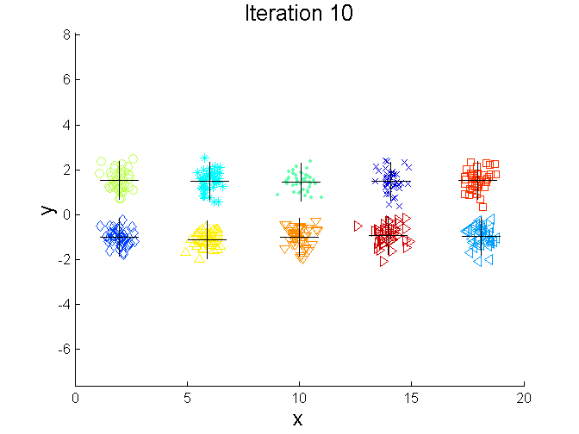
Bisecting K-means Example

Slide 43
Limitations of K-means
K-means has problems when clusters are of differing
Sizes
Densities
Non-globular shapes
K-means has problems when the data contains outliers.
One solution is to use many clusters.
Find parts of clusters, but need to put together.

Slide 44
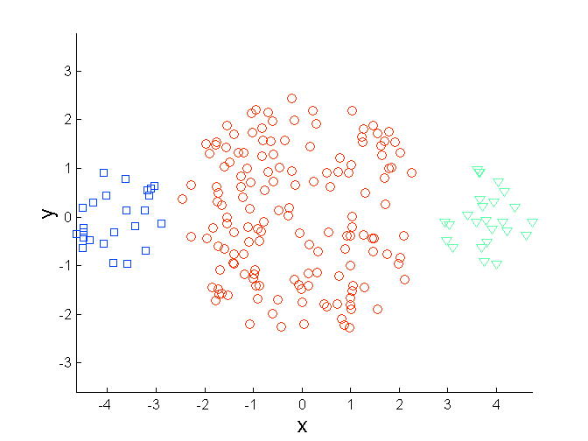
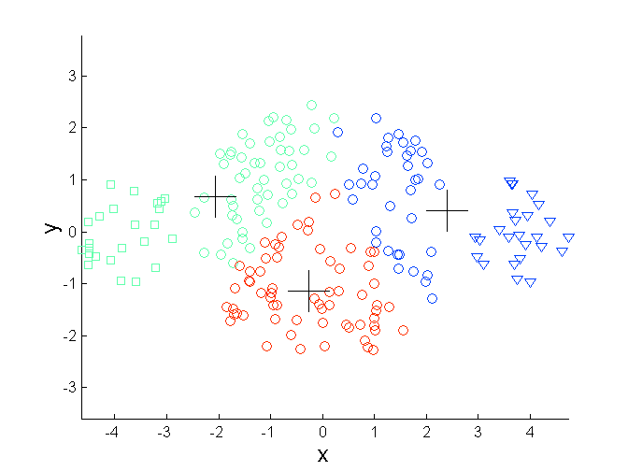
Limitations of K-means: Differing Sizes
Original Points K-means Clusters

Slide 45
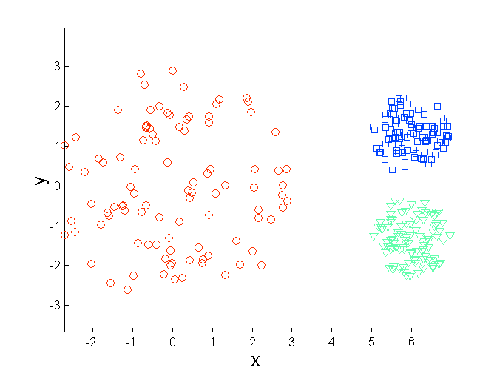
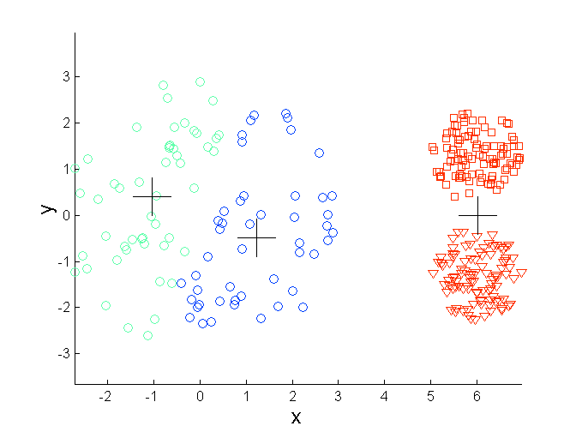
Limitations of K-means: Differing Density
Original Points K-means Clusters

Slide 46
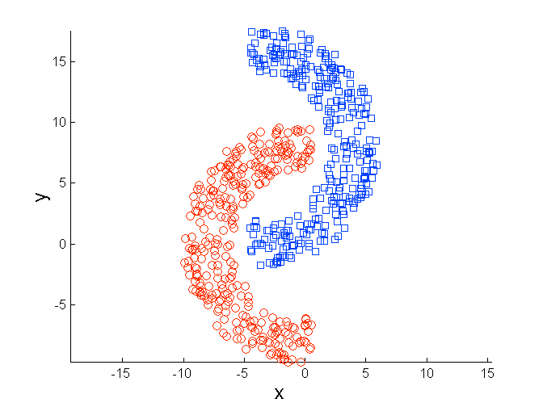
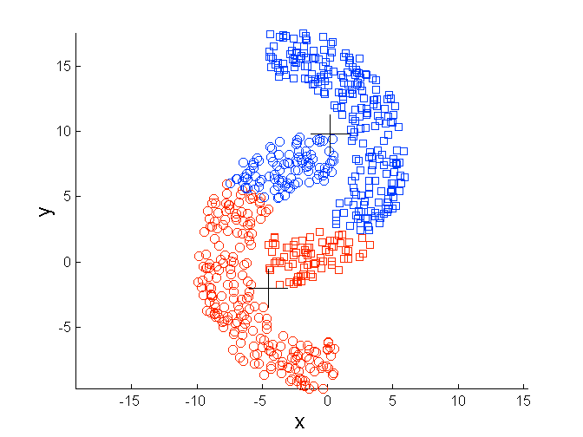
Limitations of K-means: Non-globular Shapes
Original Points K-means Clusters

Slide 47
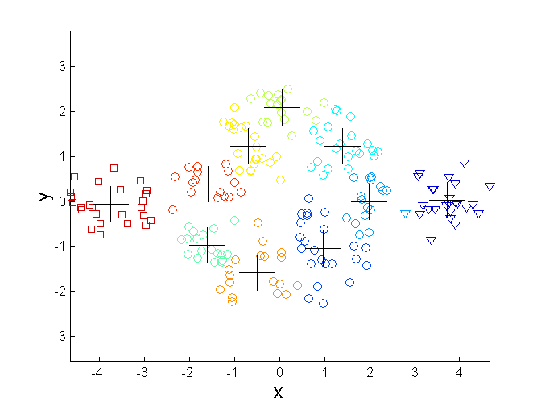
Overcoming K-means Limitations
Original Points K-means Clusters

Slide 48
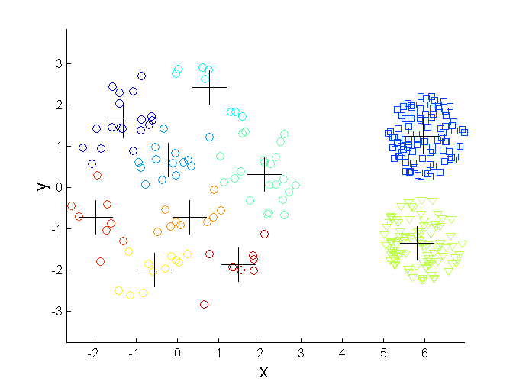
Overcoming K-means Limitations
Original Points K-means Clusters

Slide 49
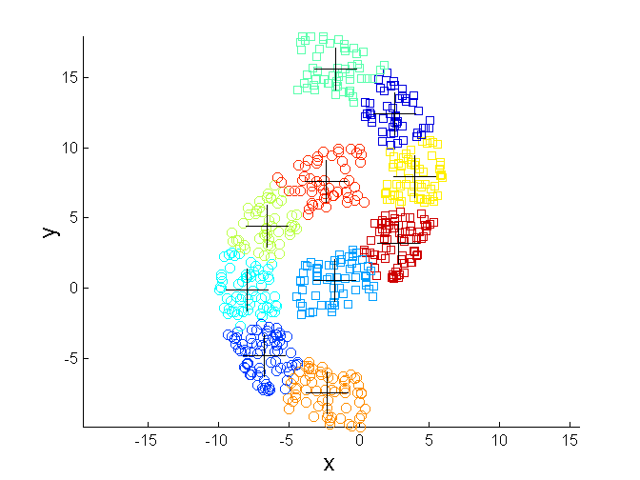
Overcoming K-means Limitations
Original Points K-means Clusters

